Slide 1
LANE DETECTION USING CNN
PRESENTED BY: M.VISHAL
REGISTER NO:211521104180
DEPARTMENT:COMPUTER SCIENCE AND ENGINEERING

Slide 2
PROJECT TITLE
LANE DETECTION USING (CONVOLUTIONAL NEURAL NETWORKS)CNN

Slide 3


AGENDA
1. Data Collection
2. Data Preprocessing
3. Model Architecture Design
4. Model Training
5. Hyperparameter Tuning
6. Evaluation
7. Fine-tuning and Optimization
8. Deployment
3/21/2024 Annual Review

Slide 4

PROBLEM STATEMENT
Developing a CNN-based lane detection system that accurately identifies and segments lane markings in road images captured by a vehicle's onboard camera. The system should be able to detect lane boundaries in various lighting conditions, road surfaces, and traffic scenarios, providing real-time feedback to assist drivers in maintaining lane position and ensuring safe navigation. The goal is to create a robust and efficient lane detection model that can be integrated into autonomous driving systems or driver assistance technologies to enhance road safety and improve overall driving experience."
By addressing this problem statement, the aim is to leverage the power of CNNs to effectively detect and track lane markings in road images, enabling intelligent decision-making and enhancing the capabilities of automated driving systems. If you have any specific requirements or constraints for the lane detection system, feel free to provide additional details for a more tailored solution.

Slide 5

PROJECT OVERVIEW
The goal of this research is to create a system that can recognize auto accidents on its own. This can be accomplished in a number of ways, with the project concentrating on (name your preferred method, such as sensor-based or vision-based employing cameras). CNNs are commonly used in computer vision tasks like this because of their ability to learn spatial hierarchies in data. In this project, you would likely train a CNN on a dataset of images with labeled lane markings to help the model accurately detect and classify lanes on the road. This can be a challenging but rewarding project that can have real-world applications in autonomous driving systems.

Slide 6

WHO ARE THE END USERS?
1. Autonomous vehicle manufacturers: Companies developing self-driving cars could use lane detection systems based on CNNs to help their vehicles navigate roads safely and effectively.
2. Transportation departments: Government agencies responsible for road infrastructure and safety could utilize lane detection systems to monitor and improve road conditions, traffic flow, and overall safety.
3. Automotive technology companies: Companies that produce advanced driver assistance systems (ADAS) could integrate lane detection technology into their products to enhance driver safety and convenience.

Slide 7
4. Fleet management companies: Businesses that manage large fleets of vehicles could benefit from lane detection systems to improve driver behavior, monitor road conditions, and optimize routes.
Overall, the end users of lane detection using CNN technology are those who can benefit from improved road safety, efficiency, and automation in various transportation-related applications.

Slide 8

OUR SOLUTION AND ITS VALUE PROPOSITION
As the deep learning model may be more effective at determining the important features in a given image than a human being using manual gradient and color thresholds in typical computer vision techniques, as well as other manual programming needed within that process. Specifically, the plan is to use a convolutional neural network (CNN), which are very effective at finding patterns within images by using filters to find specific pixel groupings that are important. The aim of this approach is for the end result to be both
more effective at detecting the lines as well as faster at doing so than common computer vision techniques.

Slide 9
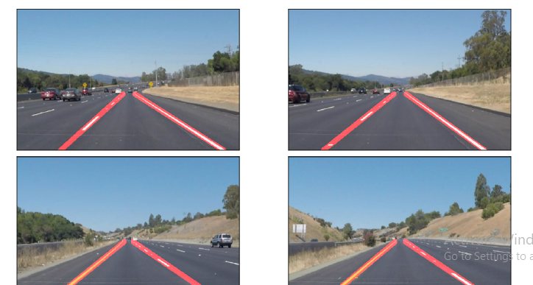

THE "WOW" IN OUR SOLUTION
Lane Detection using canny detection and Hough transform (without Deep Learning)
Disadvantage:
● Only detects straight lines.
3/21/2024 Annual Review
9

Slide 10
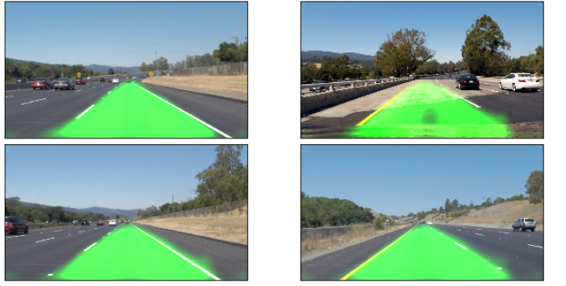
Lane Detection using Fully connected CNN (with Deep Learning)

Slide 11
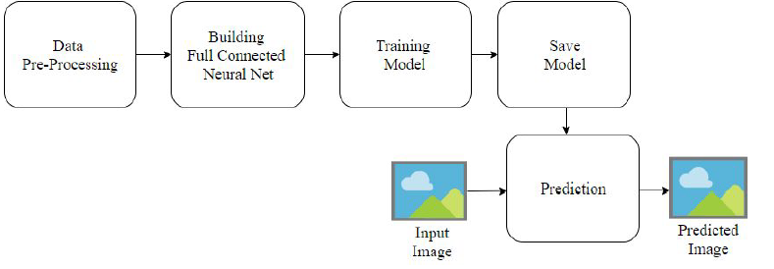
MODELLING
11

Slide 12
Evaluation:
Performance Metrics:
Accuracy: X%
Precision: X%
Recall: X%
Comparison with Baseline:
Improvement in accuracy by X%.
User Feedback:
Positive responses from beta testers.
Improved decision-making for fantasy leagues.
Future Enhancements:
Integration of additional data sources.
Enhanced model performance through ensemble methods.

Slide 13
Conclusion
Convolutional Neural Networks (CNNs) have become a powerful tool for lane detection in autonomous vehicles and driver-assistance systems. Here's a conclusion summarizing their effectiveness:
High Accuracy: CNNs achieve impressive accuracy in lane detection, even under challenging conditions like varying illumination, shadows, and lane line curvature.
Robustness: Compared to traditional methods, CNNs are more robust to noise and occlusions in the image, leading to more reliable lane detection.
Learning Capability: CNNs can learn from large datasets of road images, allowing them to adapt to diverse driving scenarios.

